Slide 1
Access Controls
4.2: Linux Access Controls

Slide 2
Class Objectives
By the end of today’s class, you will be able to:
Audit passwords using john.
Elevate privileges with sudo and su.
Create and manage users and groups.
Inspect and set file permissions for sensitive files on the system.

Slide 3
A Brief Introduction to Hashes and Password Cracking

Slide 4

Password Hashes
A hash is a cryptographic function that takes data as input and translates it to a string of different, random-looking data.
My Plain Text Password My Password Hash
ApPles2Orang3s93
579de3a38386c62a1eca4600e3882b8b
A hash will always output the same string for the same input data.

Slide 5

Password Hashes
The hash is stored in the shadow file.
When a user logs in, the hash of the submitted password is compared to the hash stored in etc/shadow.
If the hashes match, the user’s logged in.
Notes:
shutterstock_782515144

Slide 6
Password Cracking
A hash is a cryptographic function that takes data as input and translates it to a string of different, random-looking data.
My Plain Text Password My Password Hash
ApPles2Orang3s93
579de3a38386c62a1eca4600e3882b8b
Password cracking tools cannot reverse a password hash.

Slide 7
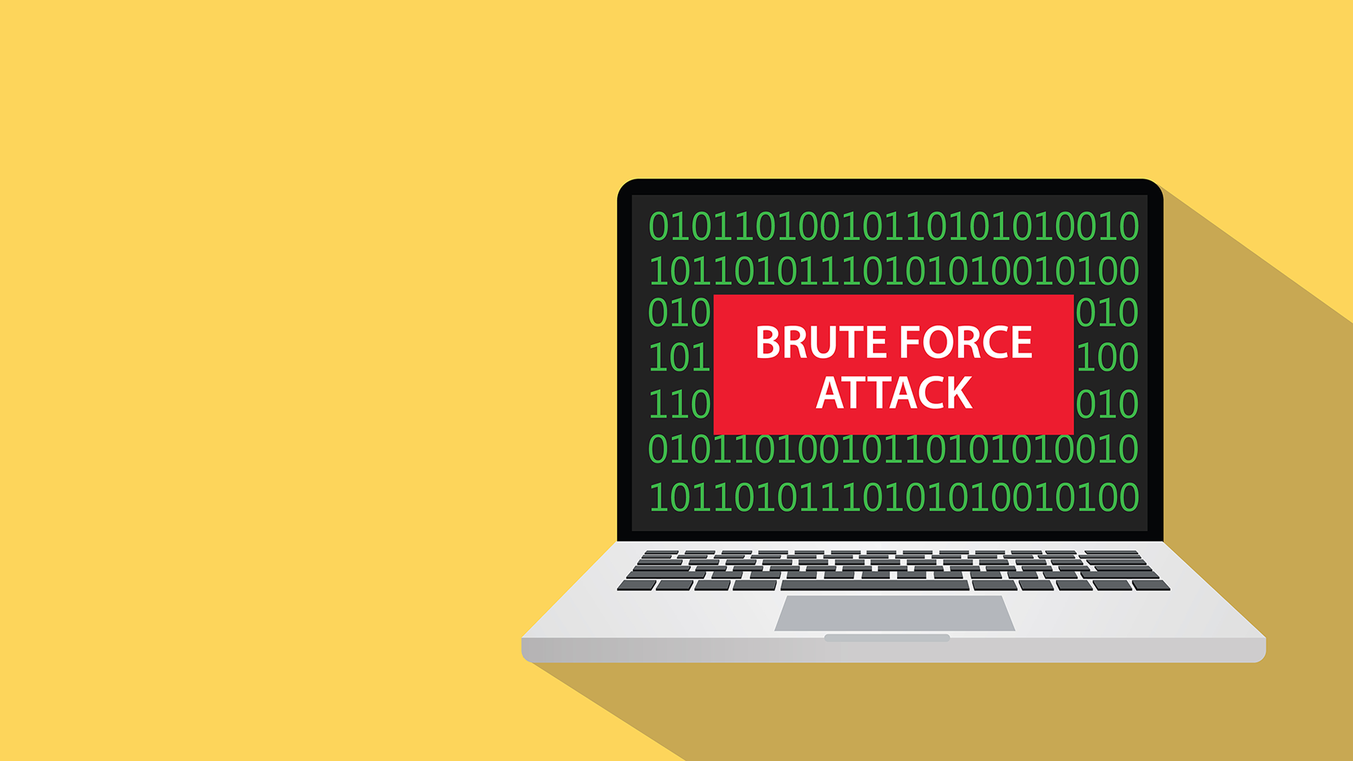
Password Hashes
Password cracking tools cannot reverse a password hash.
Instead, they use a wordlist of potential passwords and create hashes for each one.
This form of password hacking is called a brute force attack.
Notes:
shutterstock_599075294

Slide 8
The more random and lengthy the password, the longer it will take to crack.

Slide 9
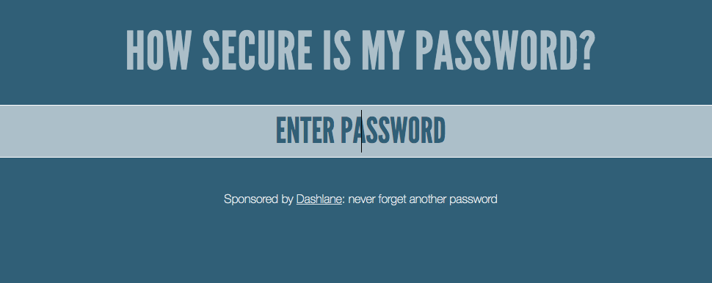
How secure is my password?
Go to howsecureismypassword.net.

Slide 10
Secure Password Takeaways
If a system requires passwords of only sixteen characters, the password will be relatively strong, even if it contains words.
Add a few extra characters and it will become exponentially more secure.
In contrast, if using all random characters, a password still must be at least 10 characters to be very effective.

Slide 11
Cracking Passwords
Modern password cracking software works using the following steps:
Takes a list of hashes as input.
Hashes passwords from a given password list and compares each hash to the list of hashes it was given.
If it matches a hash, it gives outputs of what password was used to create the hash.

Slide 12

Password Cracking and John the Ripper
Modern password cracking software works uses the following steps:
Takes a list of hashes as input.
Hashes passwords from a given password list and compares each hash to the list of hashes it was given.
If it matches a hash, it gives outputs of what password was used to create the hash.
John the Ripper is a popular modern software that uses this technique to crack a wide variety of hashes.

Slide 13
John the Ripper

Slide 14
Activity: Let’s Talk to John
In this activity, you will continue your role as a junior administrator auditing a system. Now, the focus is on passwords.
You will use john to crack the password hashes for all of the users on our system.
20 Minutes

Slide 16
Privileges, root, sudo, and su

Slide 17

We’ve used sudo for several commands in this unit.
Why do you think some commands require sudo and others don’t?

Slide 18
Privileges and Users
Why do we need to use sudo for some commands and not others?
Users
Groups
Root
Every file and program on a Linux system has permissions.
These permissions tell the system which users can access a file or run a program.
Users can be placed in groups, which can have their own permissions.
File and program permissions apply to all users except the root.
The root user (or super user) has complete access to the system and can perform any task.

Slide 19
Root Access
When attackers try to gain access to a system, they often try to gain root access.
Secure Linux systems do not allow just anyone to log in as the root user on the system.
sudo (superuser do) can grant a user root privileges for one command.
When the one sudo command is done, the user is reverted to their normal access.
sudo can also control which commands the user can run as root.

Slide 20
Su Demo
In the following demo, we will attempt to update all of our existing software packages:
If our privileges do not allow us to do so, we will first use su to switch directly to the root user.
We’ll show the dangers of working directly as the root user.
Then, we'll do the same updates by using sudo instead and show why this is the more secure option.

Slide 21
su vs. sudo

Slide 22
Sudo Demo Summary
In the previous demonstration, we covered the following commands:
whoami | Determines the current user.
su | Switches to another user, in this case the root user.
sudo | Invokes the root user for one command only.
sudo -l | Lists the sudo privileges for a user.
visudo | Edits the sudoers file.

Slide 23
Activity: Sudo Wrestling
In this activity, you will continue your role as a junior administrator auditing the system:
The senior administrator has asked you to audit the system for sudo and root access, making sure no users other than the admin user have access to any sudo use.
You must log in as each user, check their privileges, edit the sudoers file, and look for anything else suspicious.
25 Minutes

Slide 26
Users and Groups

Slide 27

Users and Groups
Sales
Users on a Linux system can be added to groups.
Linux has the ability to create groups of users for functions like file and service sharing.
Marketing
If a company has different departments, like Sales, Accounting, and Marketing, a Linux admin can create a group for each department. Only users in each group can access files owned by the group.
Accounting
Notes:
shutterstock_422379706

Slide 28


Users and Groups
A system admin must know how to to add and remove users to a system, add and remove groups, and add or remove users from groups.
Soon we’ll discuss commands specifically used for user and group management.
But first, let’s see how Linux identifies users and groups in the system.
Notes:
shutterstock_412967095

Slide 29
id command
Linux identifies users and groups in the system using the id command:
Linux associates a specific number with each user, known as the user ID (UID).
When Linux needs to identify a user, it uses the UID, not the username.
System users have a UID that is less than 1000.
Standard users have a UID that is greater than 1000.
The root user always has the UID of 0.

Slide 30


Users and Groups Demo Scenario
In the upcoming demo, we’ll dive into more actions for user and group management using the following scenario:
Your company recently made changes to the developer team.
Mike, a lead developer, has left the company.
Joseph has joined as a new junior developer.

Slide 31




Users and Groups Demo Scenario
The company’s Linux system has never been set up properly with a developers group. Instead, Mike was part of the general group.
General Group

Slide 32
Users and Groups Demo Scenario
As the sysadmin for this system, you need to remove Mike from the general group, remove the general group, and delete Mike from the system.
x
x
General Group
Mike, a lead developer, has left the company.

Slide 33


Users and Groups Demo Scenario
Then, you need to add Joseph to the system, create a developers group, and add Joseph to this group.
+
+
Developers Group
Joseph has joined as a new junior developer.

Slide 34
Users and Groups Scenario
To accomplish these tasks, we will use the following commands:
groups | Get group info for the user mike.
usermod | Lock Mike’s account to prevent him from logging in.
usermod | Remove the user mike from the general group.
deluser --remove-home | Delete the user mike.
delgroup | Delete the general group.
adduser | Create the user joseph.
addgroup | Create a developer group.
usermod | Add the user joseph to the developer group.
X
+

Slide 35
Users and Groups

Slide 36
Activity: Users and Groups
Your senior administrator has asked you to audit all the users and groups on the system.
You must create a new group for the standard users and remove users from the sudo group.
In the previous activity, you found some malicious users. Now, you will remove them from the system entirely.
20 Minutes

Slide 38
Any Questions?

